Slide 1

Social media listening tools
…

Slide 2
Understanding social media engagement
Where the tools have come from?
Where the tools are currently?
Where the tools go from here?

Slide 3
Media monitoring tools
Other ways you utilize other than traditional media monitoring:
Ability to schedule content
Pitch Ideas
Measurement/Reporting
Understanding Media Tendencies
Your access to this site has been limited by the site owner (cognitivegroup.com)

Slide 4
what did the social media monitoring tools do?
There are four things they did to overcome the stereotypes inherited from the traditional media-monitoring world:
Rebranded itself as listening
Actively evangelized and provided thought leadership
Created “pretty” and usable dashboards
Aggregated data

Slide 5
learning
Communicators and researchers alike had an opportunity to learn several things about their brand that they previously were not able to access, including the following:
Location of conversations
Sentiment
Key message penetration
Key influencers

Slide 6
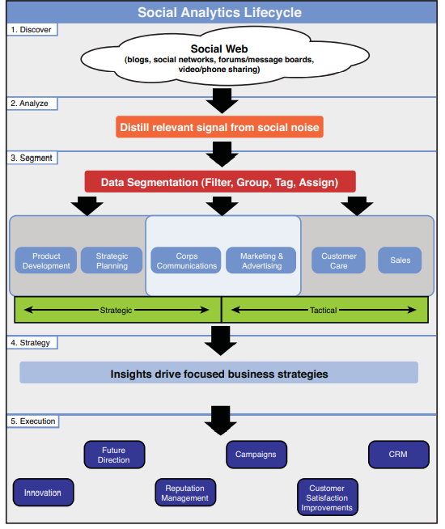
social analytics lifecycle
The social analytics lifecycle concept has five distinct stages:
Discover
Analyze
Segment
Strategize
Execute

